Slide 1
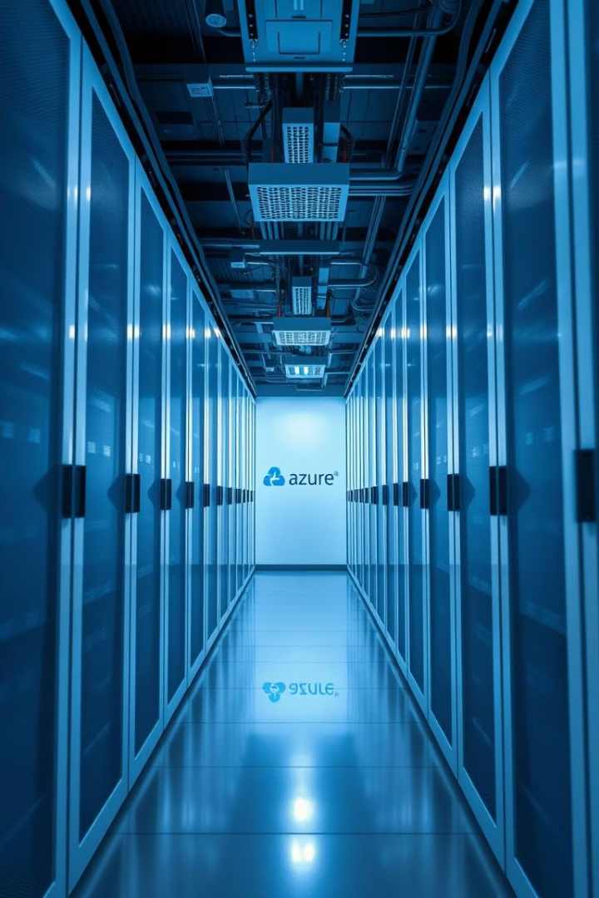
Azure Cloud Infrastructure Deployment Guide
This presentation offers a comprehensive step-by-step guide to deploying and managing Azure Cloud infrastructure using the Azure Portal. It covers fundamental concepts, resource setup, deployment, storage solutions, and final integration over a four-week cadence. The guide includes best practices, portal navigation, and screenshots to assist in effective cloud management.

Slide 2
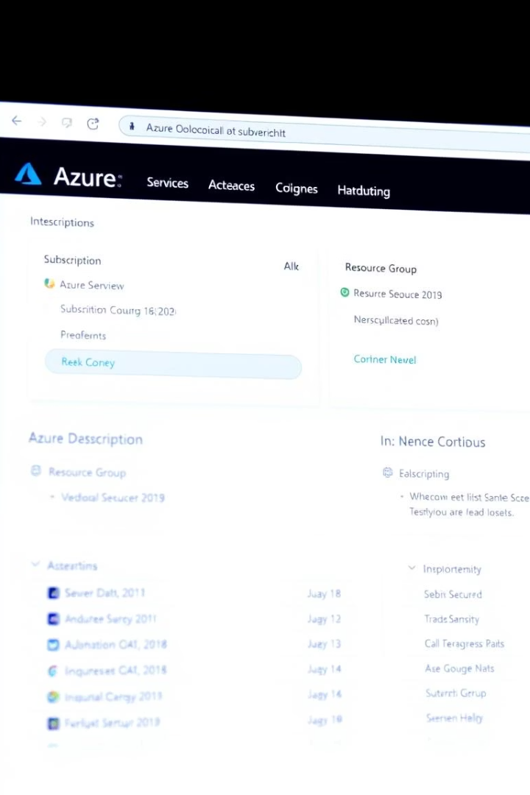
Getting Started: Prerequisites & Naming Conventions
Prerequisites
Azure Subscription with Owner or Contributor role
Modern browser access to https://portal.azure.com
Permissions to create resource groups, VMs, VNets, storage accounts, and configure Azure AD
Optional tools: Azure Architecture Diagrams (Visio or Draw.io)
Naming Conventions & Tagging
Resource Group: -rg- (e.g., prod-rg-webapp-weu)
Virtual Network: -vnet-
Subnet: -subnet-
Network Security Group: -nsg-
Virtual Machine: -vm-
Storage Account: st
Tags: Environment, Project, Owner, CostCenter

Slide 3
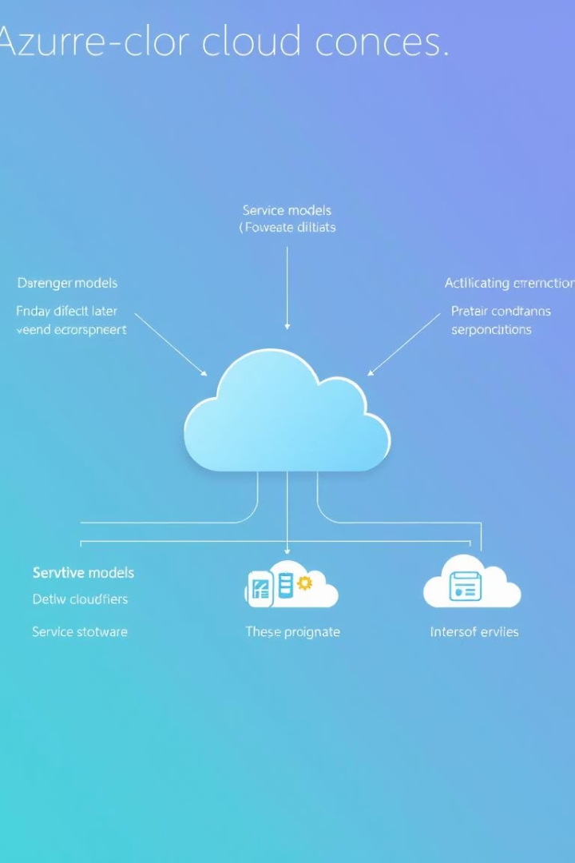
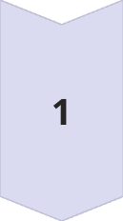
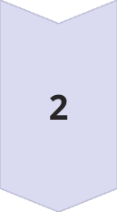
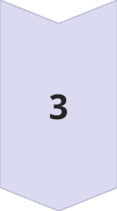
Week 1: Azure Fundamentals & Setup
Azure Concepts Overview
Understand cloud models: Public, Private, Hybrid, Community. Learn service models: IaaS, PaaS, SaaS. Key benefits include cost-efficiency, scalability, reliability, security, and innovation acceleration.
Subscription Setup
Sign in to Azure Portal, select or create a subscription, review billing and role assignments, and add users or groups with Owner/Contributor roles.
Resource Group Creation
Create resource groups with appropriate subscription, name, region, and tags. Group resources sharing a lifecycle and apply RBAC at the group level for management efficiency.

Slide 4
Week 2: Deploy and Manage Azure Resources
Virtual Machine Deployment
Network Configuration
Select subscription and resource group
Create virtual network and subnet with address spaces
Name VM and choose region, image, and size
Configure admin account and networking
Set up Network Security Group (NSG) with inbound rules
Enable boot diagnostics, auto-shutdown, and backup
Associate NSG with VM NIC or subnet
Use NSGs to segment traffic and monitor with Azure Network Watcher

Slide 5

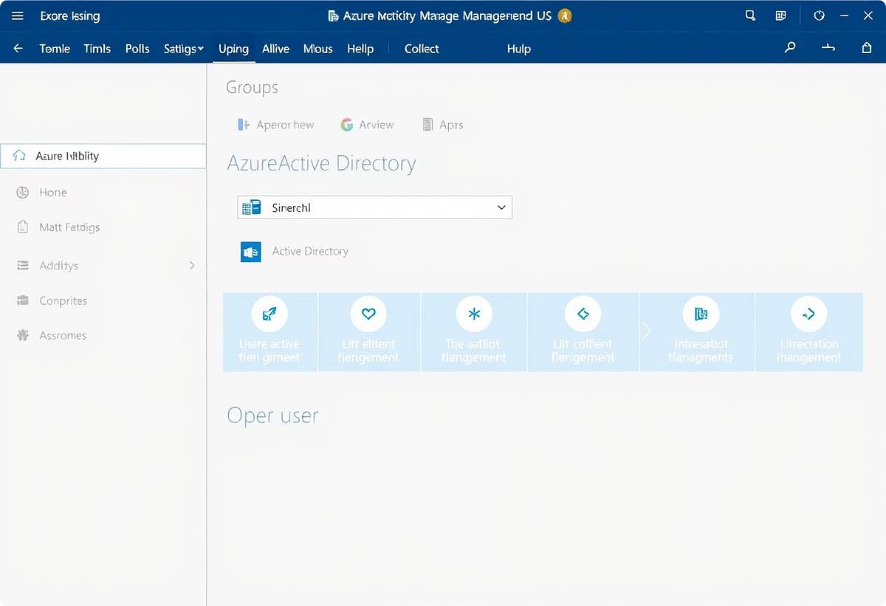
Azure Active Directory Configuration
User and Group Management
Role Assignments
Assign roles like Contributor to users or groups via Access control (IAM) for subscription management.
Create new users and security groups to organize access.
Best Practice
Use groups for easier management and enforce least privilege access.

Slide 6
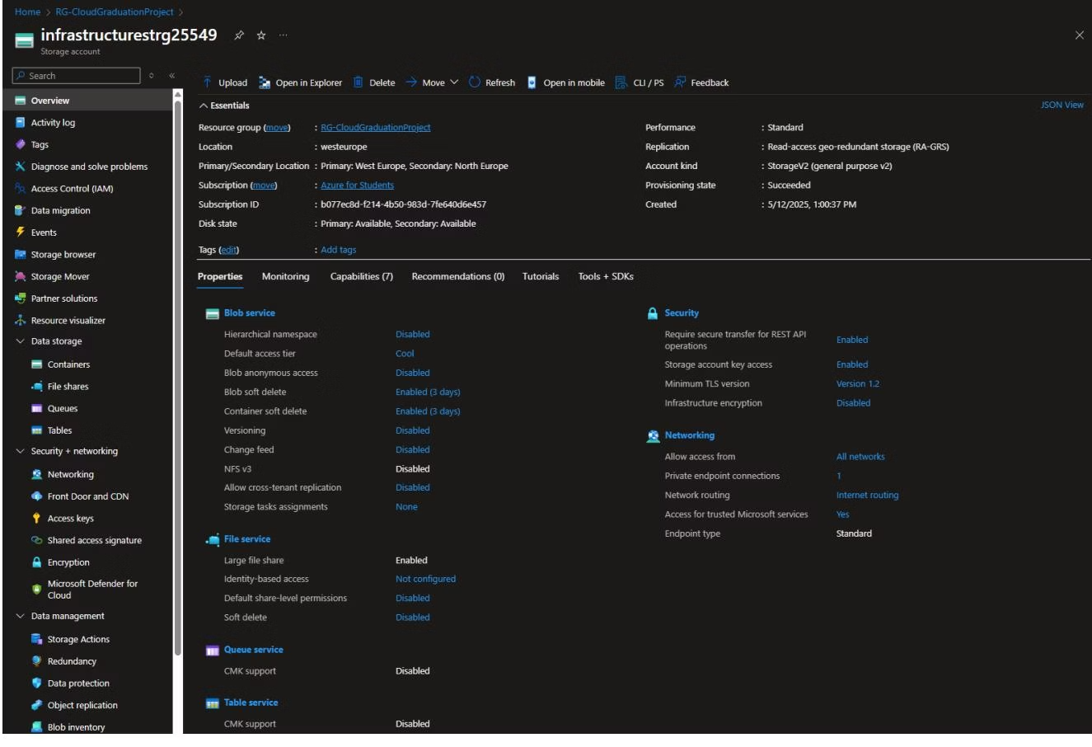
Week 3: Implement Storage Solutions
Storage Account Provisioning
Blob Storage Configuration
Configure subscription, resource group, name, location
Create containers with private access
Choose Standard performance and Geo-redundant replication
Manage blobs and change access tiers (Hot, Cool, Archive)
Enable soft delete and secure transfer
Select private or public endpoint

Slide 7
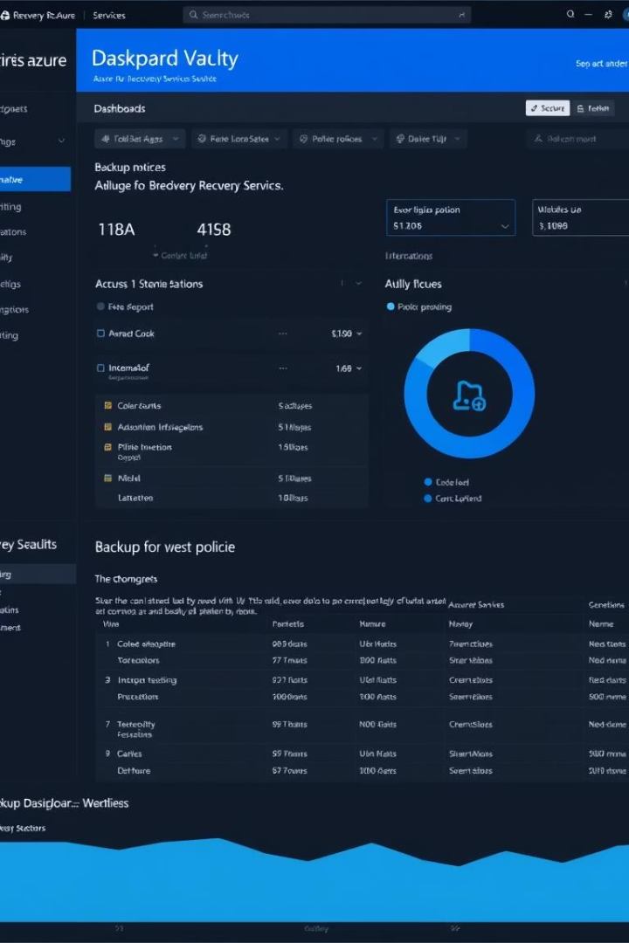
Backup Solutions and Recovery Services Vault
1
Vault Setup
2
Configure Backup
Create Recovery Services vault with subscription, resource group, and region.
Select workload type, start discovery, choose VMs to back up, and enable backup policies.
3
Best Practice
Regularly test restore processes and document Recovery Time Objectives (RTO) and Recovery Point Objectives (RPO).

Slide 8
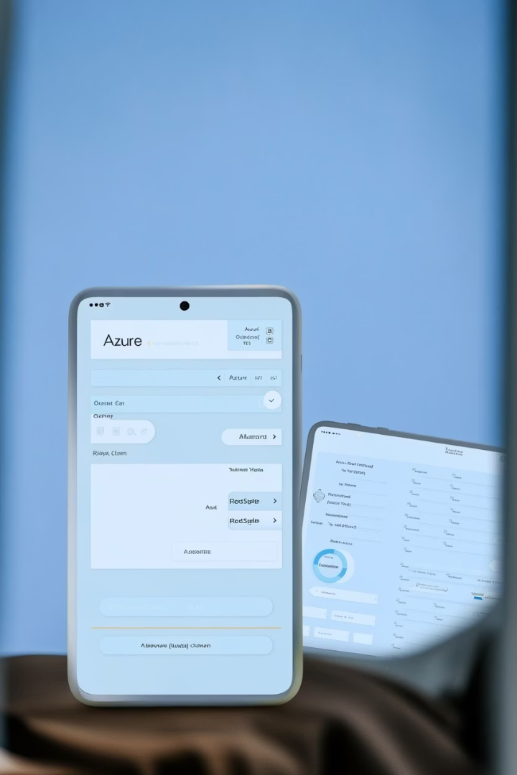
Week 4: Final Integration & Testing
Connectivity Verification
Verify VM subnet and NSG assignments, run ping tests via Cloud Shell, and review Network Watcher connectivity checks.
Identity & Access Validation
Test login with non-admin users and validate access patterns using Azure AD sign-in logs.
Backup & Restore Simulations
Restore VM backups to new or existing resource groups and confirm operational status.

Slide 9

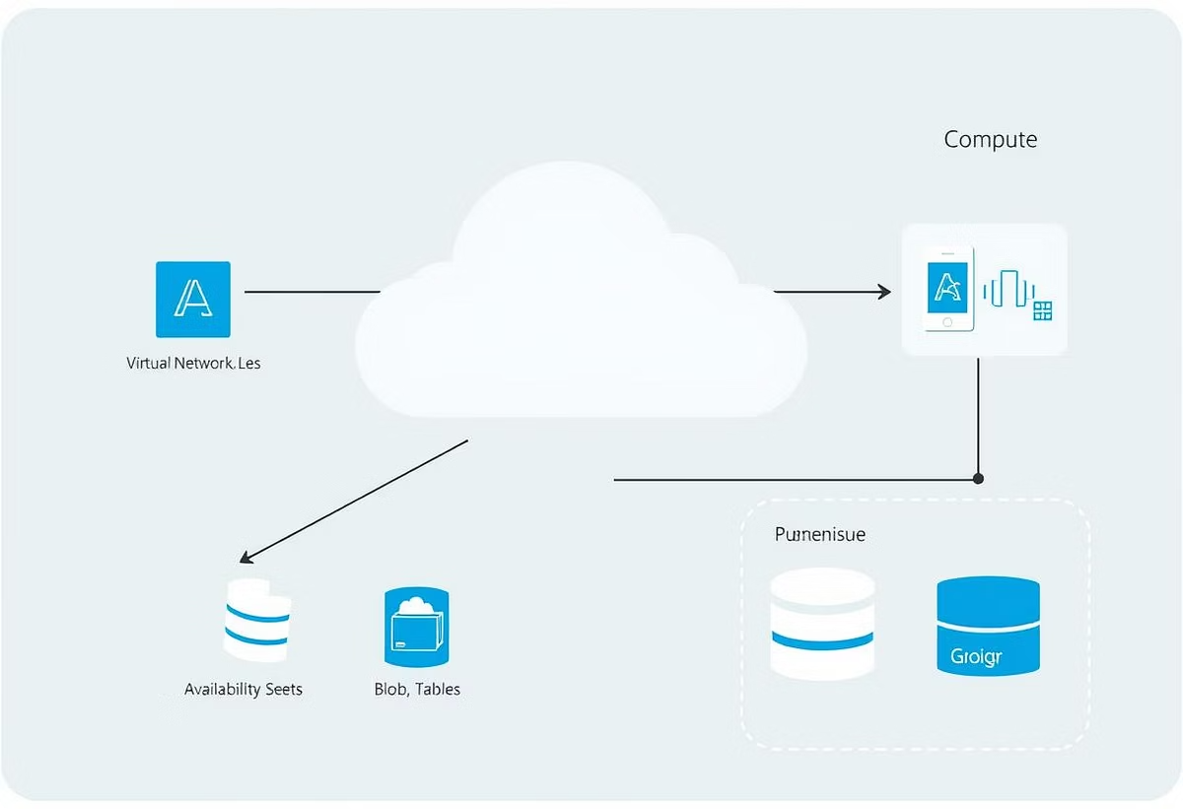
Documentation & Presentation
Architecture Diagrams
Presentation Assembly
Create detailed diagrams using Visio or Draw.io and export as PNG for documentation.
Summarize objectives, architecture, deployment highlights, testing results, and next steps in PowerPoint.
Artifact Management
Upload all documents and presentations to a shared repository like Azure DevOps Wiki for team access.

Slide 10
Appendices: ARM/Bicep Snippets & Glossary
ARM/Bicep Snippet Example
Glossary
VNet: Virtual Network
resource rg 'Microsoft.Resources/resourceGroups@2021-04-01' = {
name: 'prod-rg-webapp-weu'
location: 'westeurope'
}
NSG: Network Security Group
SKU: Pricing tier of Azure resources

